Slide 1
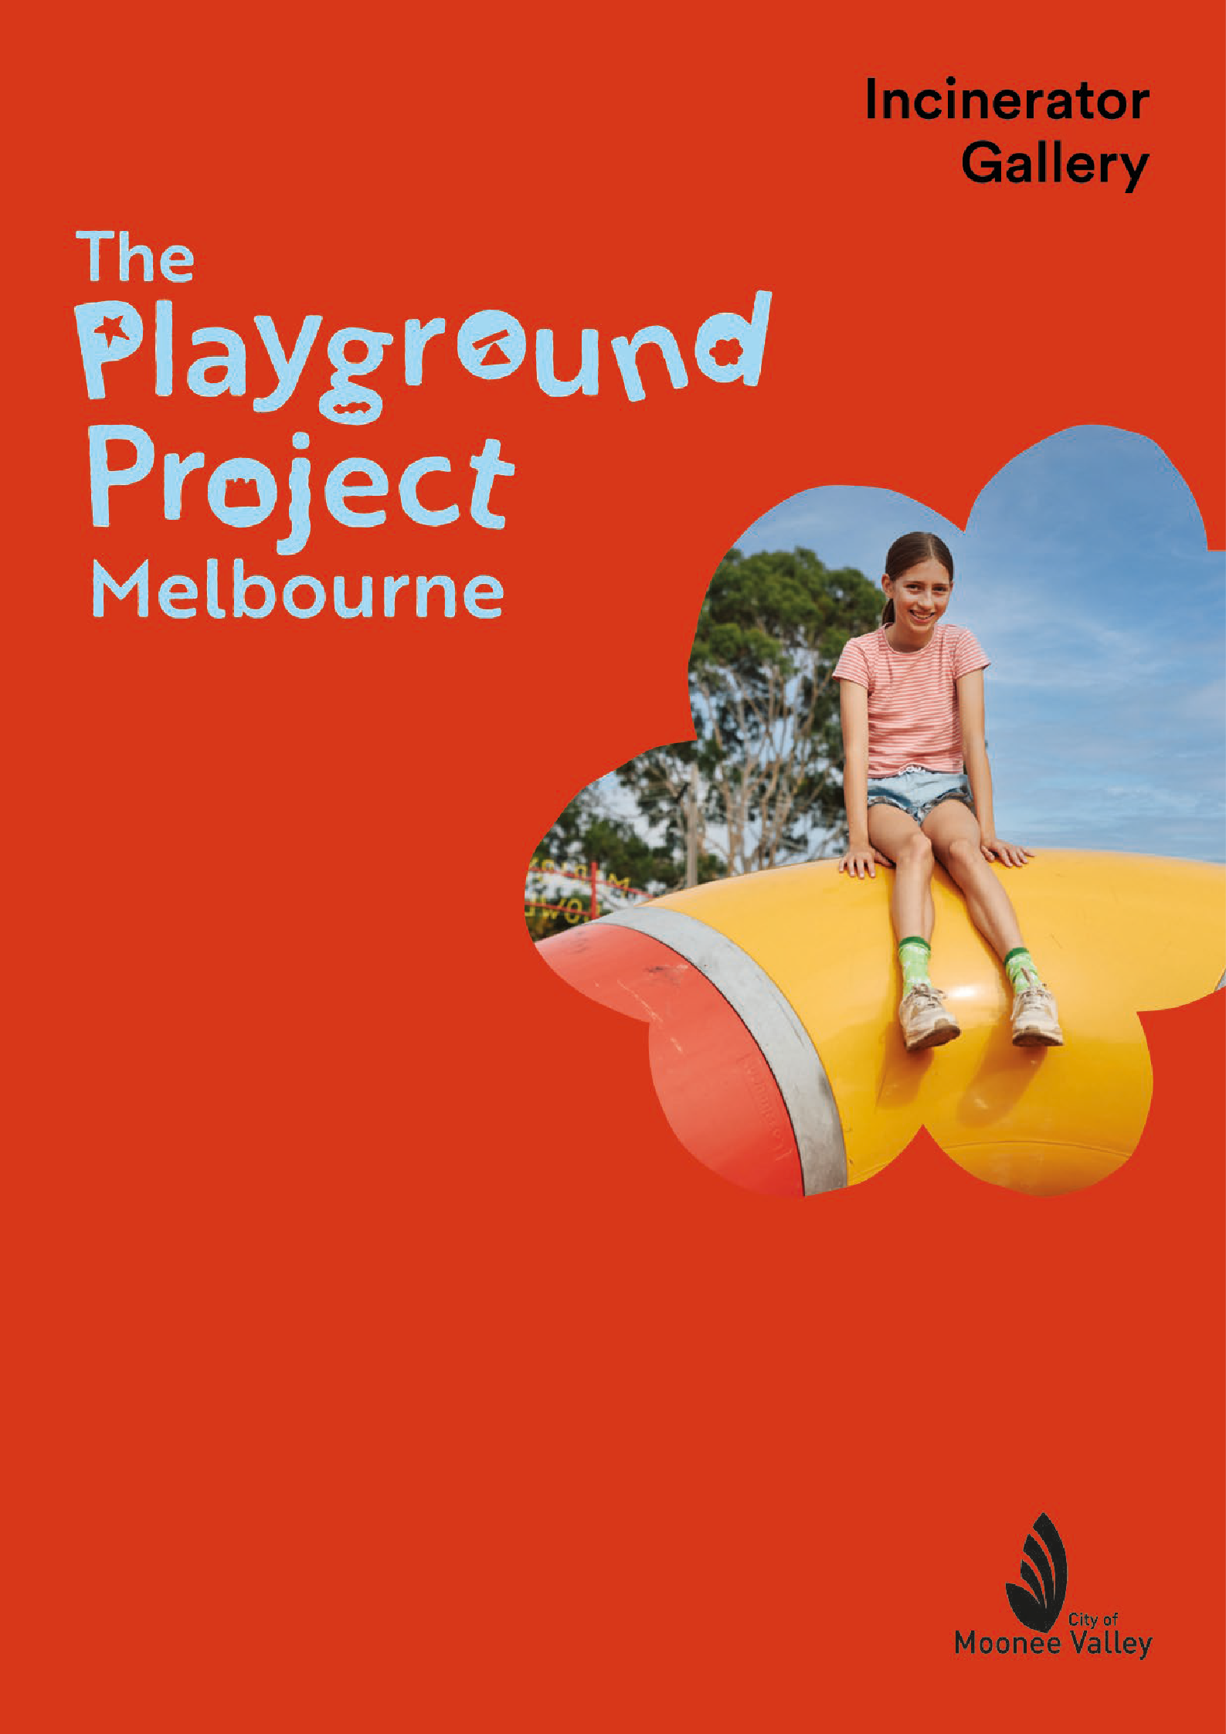
Education Resource
Foundation – Year 6
Page 4

Slide 2

The Playground Project Melbourne
About the Exhibition
The Playground Project Melbourne is an interactive, international travelling exhibition realised by guest curator, Gabriela Burkhalter and produced with Kunsthalle Zürich. Previously shown in 2020 National Architecture Museum, Frankfurt, Germany, 2018 Children’s Museum, Venice, Italy 2018 Garage Museum of Contemporary Art, Moscow, Russia, 2018 City Museum, Bonn, Germany 2017 Visual Centre for Contemporary Art, Carlow, Ireland, 2016 Baltic, Newcastle, UK, 2016 Kunsthalle, Zurich, Switzerland and 2013 Carnegie International, Pittsburgh, USA
It explores a unique chapter of late 19th century to early 21st century art, design, urbanism and activism, highlighting some of the most innovative playgrounds over the last 150 years. It introduces audiences to some of the key designers and artists from around the world who have been pioneers in the field of playground design.
In its iteration at Incinerator Gallery, it presents Gabriela Burkhalter’s research into the history of playground design with extensive large scale photographic, archival, sound and moving image documentation. Including Gabriela Burkhalter’s latest research into the history of playgrounds in Melbourne, Australia.
The highlight of the exhibition are the four playgrounds, offering children a place to explore, climb and imagine. Indoors are two play sculptures The Lozziwurm designed in 1972 by Swiss artist Yvan Pestalozzi and The Brutalist Playground created by Australian artist Simon Terrill and Assemble, a UK based design studio.
Outdoors Incinerator Gallery presents two new public art commissions, created in response to The Playground Project: The Ringtales Playground by Board Grove Architects and Moonee Valley City Council’s First Nations Playable Public Art Sculpture by Trawlwoolway artist Edwina Green.
Also showing outdoors is Round Table 2017 by leading Australian artist Emily Floyd in collaboration with British-born pioneering designer and activist Mary Featherston AM.

Slide 3
Suitable for Prep (Foundation) to Year 6
About: The Education Resource
This education resource is to provide support for teachers, parents and primary school students from Prep – Year 6 to engage with the exhibition The Playground Project Melbourne at Incinerator Gallery.
This resource will support further learning in the classroom, before and after visiting the exhibition. Students will discover, the origins of playgrounds and the history of playground design over the last 150 years, the different types of playground designs – playable sculpture, landscape playgrounds and activist playgrounds and learn about the artists, designers, architects and activists behind the playgrounds in the exhibition.
There are two resources one to use before visiting the exhibition and one to use after
the experiencing the exhibition.
The Playground Project Melbourne – Before your Playground Experience Resource:
This part of the resource provides prompting questions and images - See, Think and Wonder to assist teachers and students in preparing for their visit to the exhibition, allowing students to think about playground design and the purpose of playgrounds. This will be accompanied with a Create activity to re-enforce this classroom discussion and give students the opportunity to come up with their own playground designs before they visit the gallery. The ‘Create’ work will provide a good discussion point when they return to the classroom after the visiting the exhibition, they can return to these designs and consider what they might keep or change about them once they have learnt more about playground design.
The Playground Project Melbourne – After your Playground Experience Resource:
This part of the resource highlights the key playground designs and playable sculptures in the exhibition, enabling students to reflect on the themes of the playground designs in the exhibition, the artists and designers behind the playgrounds with insights into their inspiration and design process. The resource uses the framework of See, Think, Wonder, and Create providing classroom activities that support the aims of the Visual Arts, Design and Technologies and Humanities curriculum. Aboriginal and Torres Strait Islander Histories and Cultures and Personal and Social Capability. Curriculum Links are at the end of this resource.

Slide 4
Page 4

Slide 5
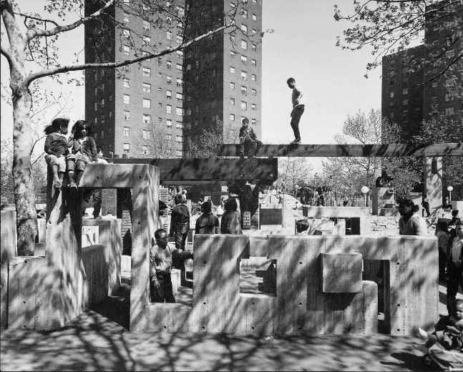
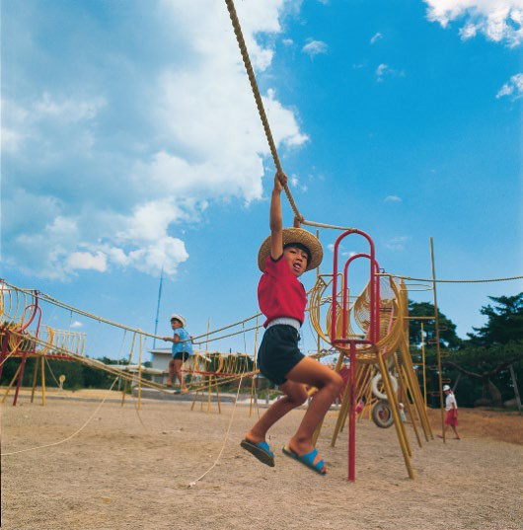
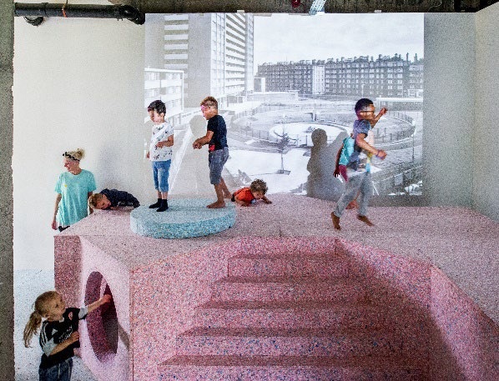
Primary: Foundation – Year 6
BEFORE YOUR VISIT
What is The Playground Project Melbourne?
The Playground Project Melbourne is a special exhibition that has travelled all around the world and is showing in Australia for the first time. It is an exhibition all about playgrounds, a place that you all know well. You will discover playgrounds from 150 years ago right up to today, and you will get to play on three different playgrounds at the exhibition as well!
At The Playground Project Melbourne, there are large-scale photos and videos of playgrounds from all different parts of the world including Europe, America and Australia.
Here are some of the playgrounds, play sculptures and landscape playgrounds you will see photos of when you visit The Playground Project Melbourne.
Did you know that artists, designers, architects, landscape architects and even local communities design and create playgrounds?
Above: M.Paul Friedberg, Riis Park Plaza, Jacob Riis Houses, New York City, 1965. Photo anon.
Above: Simon Terrill & Assemble, The Brutalist Playground Park Hill , install view at S1 Artspace, 2016.
Above: Mitsura Senda, Giant Path, play structure Mukoyama Children’s Park, Sendai, Miyagi Prefecture, 1969 Photo Yoshio Shiratori
Courtesy Environment Design Institute, Tokyo
Page 4

Slide 6
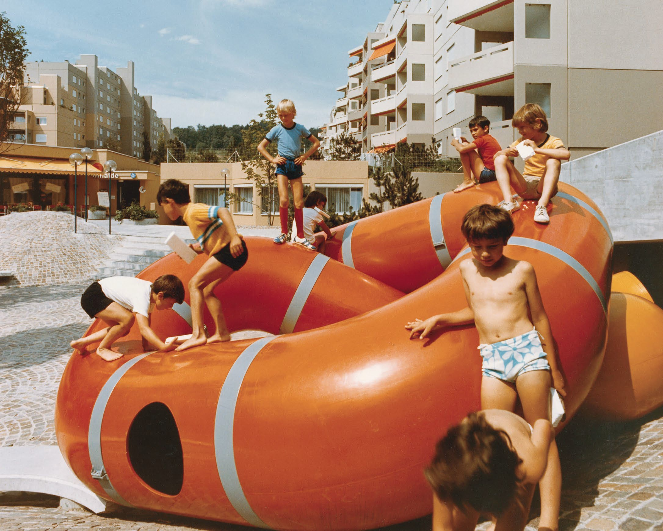
BEFORE YOUR VISIT ACTIVITY
The Lozziwurm 1972, Yvan Pestalozzi, Switzerland.
Either by yourself or with a small group answer one or two questions from each box.
SEE
THINK
WONDER
Look at your school playground what would you change about it? What would you like to play on at school?
If you could create a playground, what would it look and feel like? Would it have tunnels, feel squishy, have cubbies, ropes to swing from? Be as imaginative as you like!
What do you see in the photo above? What are the children doing?
What do you think it is made from?
What does the shape
of the playground look like to you?
Where do you think the children live who are playing on this playground?
How is this playground different from your school playground?
Why do you think the artist made this playground for these children?
What would the children do on this playground?

Slide 7
BEFORE YOUR VISIT ACTIVITY
Now you have answered some of the See, Think and Wonder questions read below to find out more about The Lozziwurm before you come and play on it at the gallery.
ABOUT
The Lozziwurm is a play sculpture designed by a Swiss artist called Yvan Pestalozzi who created large sculptures that can be walked on and played on. Yvan created this playground for the children who lived in the high rise housing estate in Zurich, Switzerland in 1972.
It is a modular sculpture which means it can be taken apart and put together in different ways. The Lozziwurm is like a winding worm or serpent inviting children to crawl through it, climb upon it and peep out of it. Yvan Pestalozzi also made wind sculptures and kinetic metal and wire sculptures.
The Lozziwurm has been reproduced many times and has been played on by children who live in different countries around the world. It has been enjoyed in schools, galleries, playgrounds and parks.
Luckily we have The Lozziwurm right here in Melbourne, and you will get to play on it at Incinerator Gallery when you visit The Playground Project Melbourne.
After the exhibition The Lozziwurm will be moved to a permanent place along the Maribyrnong River to be enjoyed by children and families for years to come.
CREATE
It’s time to design your own playground. Draw and/or create a collage of your dream playground. Be as creative as you like, let your imagination go!
Materials:
A4 cartridge paper Glue stick
Coloured paper/tissue/ cellophane Coloured markers
Coloured pencils
Some things to think about:
Where would your playground be? Would it be a playground full of shapes and textures? What would children do on your playground – hide, dig, climb, swing etc? Would there be sand to play with, things to jump on, structures to climb? What colours would your playground be? Would there be a place to hide, like a fort or cubby?

Slide 8
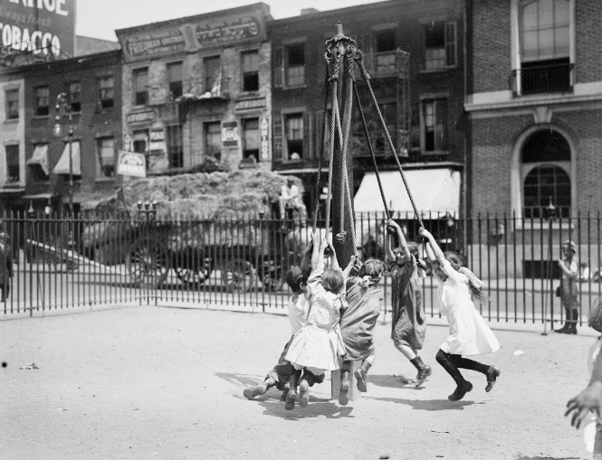
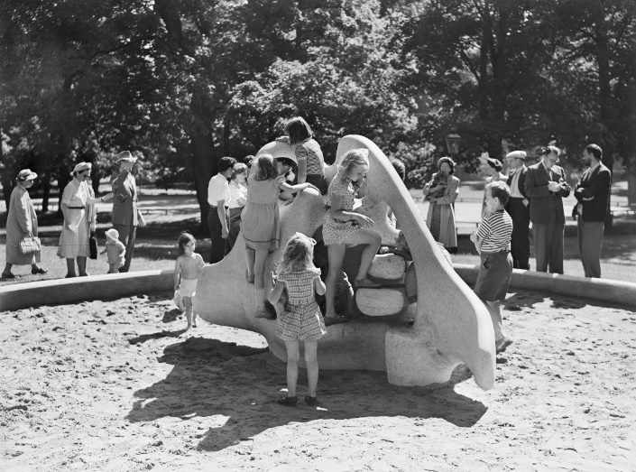
Primary: Foundation – Year 6
AFTER YOUR VISIT ACTIVITY
Historical Playgrounds Activity
1.New York Playground 1910 -1915. Library of Congress, Washington D.C 2. Egon Møller-Nielsen’s “Tuffsen” in Humlegården, Stockholm 1949.
Photographer: Sune Sundahl, DigitaltMuseum. Public domain.
Above are two photos of playgrounds; one is in New York and was taken around 1915 and the other playground is a play sculpture called Tuffsen, in Sweden and was taken in1949.
Either as a small group or in pairs, look at these two photos together and answer some of the questions below and complete the design activity.
SEE
What do you think Tuffsen (image 2) and the New York playground are made from?
What are some differences between the 1915 New York playground and the play sculpture Tuffsen?
What types of things would children do on each playground?
THINK
How are the two playgrounds pictured above different from your school playground?
Which playground would you prefer to play on? Why?
DESIGN
If you could design a play sculpture like Tuffesen for your school, what would it look like and what would it be made from?
Draw your design and label the materials it would be made from, and explain where it would be placed in your playground and why?
WONDER
Imagine you are playing on Tuffsen, what would you play?

Slide 9
ABOUT: HISTORICAL PLAYGROUNDS
The Beginning of Playgrounds
Playgrounds have changed over the last 150 years. Look at the photo above of a playground in New York in 1915. Can you guess how many years ago that was? The children at that time had simple fenced off playgrounds, they were supervised by adults with separate playgrounds for girls and boys. These playgrounds were not just for fun and playing but were created to keep children safe and off the busy streets of industrial cities.
1950s The start of New Playgrounds
In the 1950s, probably around when your grandparents were born, play was seen as an important thing for children to do, they learnt through play, made friends and enjoyed the outdoors too!
Cities were growing and there was a need for more schools, housing and hospitals but it was also very important to have parks and playgrounds too.
Playgrounds started to be designed by artists, architects and landscape architects One type of playground was the play sculpture. An early example of a play sculpture is Tuffsen in Stockholm, Sweden (see previous page). It was designed by Egon Moller-Nielsen who was an architect and a sculptor. Egon saw how much his 3yr old daughter enjoyed climbing on large stone blocks or hiding in caves or sliding down smooth rocks. Watching his daughter play like this gave him the idea to make Tuffsen, it was one of the earliest play sculptures and was created in 1949.
FUN FACT
Did you know that the oldest playground in Melbourne is in a place called Lincoln Square in Carlton? It was the first public playground to be built in Melbourne and is over 100 years old!
.

Slide 10
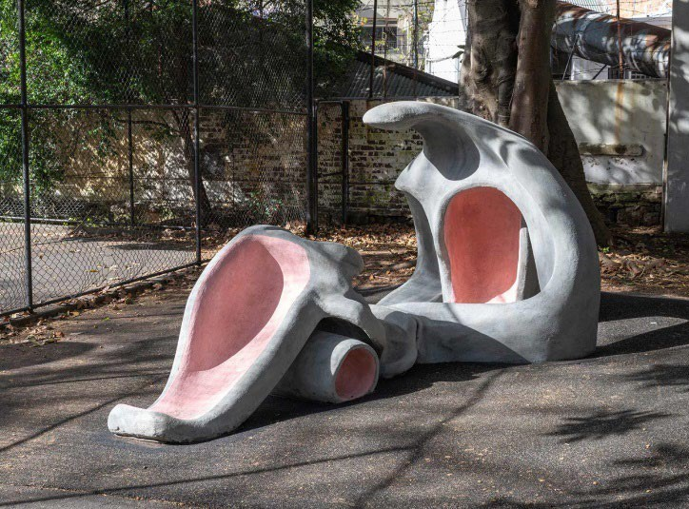
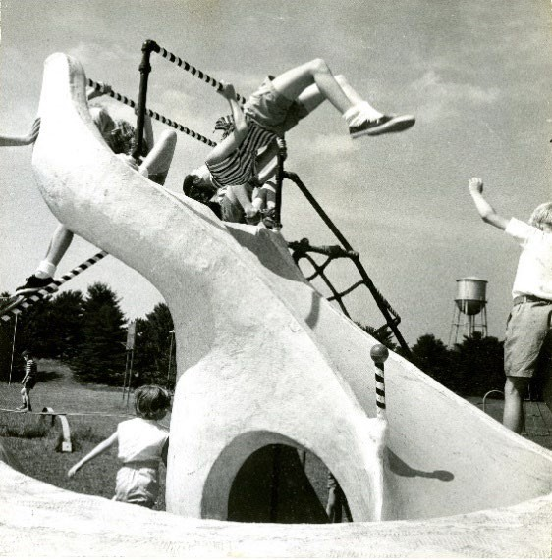
PLAY SCULPTURES
Play sculptures are large-scale public artworks that are not just for viewing but are a functional play structure and a work of art. Play sculptures encourage children and adults to interact creatively with its forms and shapes, unlike a conventional playground people can use their imagination on a play sculpture.
Anita Aarons: Earth Mother
Anita Aarons was an Australian sculptor and jeweller. When Anita created the play sculpture Earth Mother in 1952, she wanted children to play and invent on the natural and organic shapes of her sculpture. Anita looked to the natural environment for her inspiration.
Can you think of something in nature that her sculpture looks like?
What materials do you think Earth Mother is made of?
Above: Anita Aarons, Earth Mother 1952, Cook and Phillip Park Sydney 2025. Courtesy of City Of Sydney
https://www.cityofsydney.nsw.gov.au/sculptures/earth-mother-play-sculptur
Joseph Brown: Whale
Joseph Brown was a sculptor, a professional boxer and a boxing coach. He saw how important it was for young people to be active through sport and play, so he went on to design several different playgrounds for children.
One was the play sculpture, Whale with its sculptural whale form it provided many play opportunities, where children could climb upon its rounded shape, swing on the bars and ropes and hide in its cave like ‘body’.
Joseph Brown also designed Swing Ring in 1953 which was never reproduced but you can see many similar examples today in playgrounds all around the world. You might even have a similar rope structure at school.
Take a look at Swing Ring and see if you agree: https://berliner- seilfabrik.com/en/productgroup/univers/joe- brown-collection/
Above: Joseph Brown, Whale, c 1955. Photo anon. Courtesy The Playground Project.

Slide 11
PLAY SCULPTURE ACTIVITY
CREATE – MODEL PLAY SCULPTURE
TEACHERS
Discuss Anita Aarons and Jospeh Browns play sculptures:
What shapes do they see? What do they remind them of? Discuss how the artists and designers are often inspired by the world around them. Ask what do you think the artist was thinking of when they designed their playground? Ask them to think about what they would do on each of
the play sculptures. Discuss how each play sculpture offers different experiences of play through their unique design.
Before starting to make their play sculpture ask them to think about what will inspire their design. They may be inspired to create a playground based on a creature, real or mythical like Joseph Brown’s Whale or Niki de Saint Phalle’s Golem, or get inspiration from the natural environment like Anita Aarons or The Ringtales Playground by BoardGrove Architects (Pg 11). They could look at the surrounding shapes in their school building and the landscape that surrounds their school, as did Simon Terrill and Assemble when they created The Brutalist Playground (page 14).
Also, think about what children could do on their play sculpture. Will they be able to climb on it easily, hide in a little nook or crawl through a tunnel? Let them brainstorm some ideas as a group before they start making.
TEACHERS/STUDENTS
Build your own small model of a play sculpture. Materials:
Coloured plasticine, white air-dry clay (oz clay), coloured (soft) air dry clay or playdough. White air-dry clay it can be painted once dry.
Optional: pipe cleaners, toothpicks, icy pole sticks.
EXPERIMENT: Encourage your students to experiment with the clay, making shapes with their hands, squishing into abstract shapes, rolling it out, making a coil or a pinch pot.
Experimentation with the material will lead to a great design as you understand what you can do with this material.
MAKE: Roll out a small slab first and use this as a base to build the sculpture on. From your clay
experimentation use some shapes that you have made or make some new ones and begin building your playable sculpture by connecting the various pieces, smooth the clay in between each of the pieces to connect them well. The pipe cleaners, toothpicks or icy pole sticks are another good way to connect the pieces too. Also, you may want to start with one big piece of clay and mould it into a shape that you like, taking away some of the clay as you go, so a form begins to appear.
FINISH: Once dry place your model onto a thick paper plate or piece of card and create a garden landscape around it from tissue, cellophane and coloured paper and card.

Slide 12
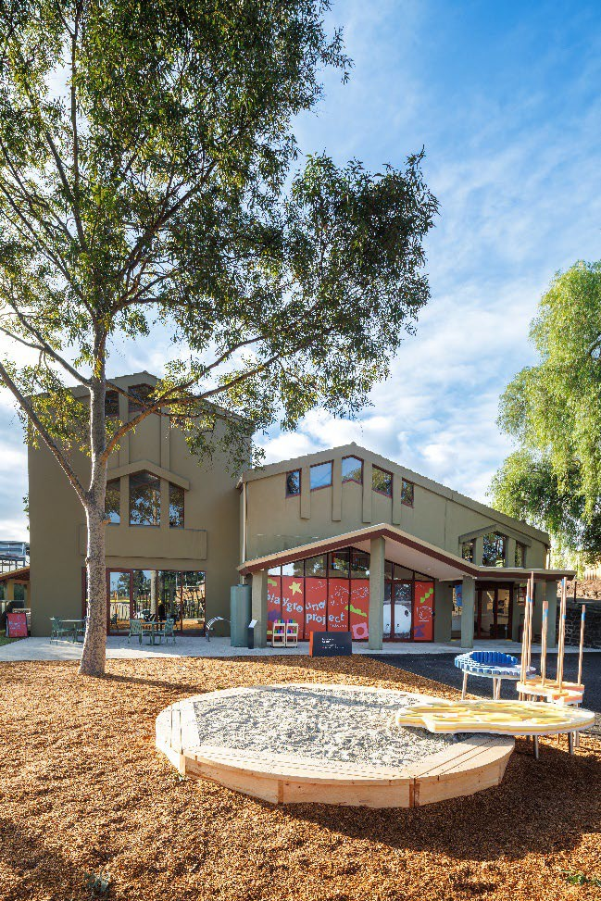
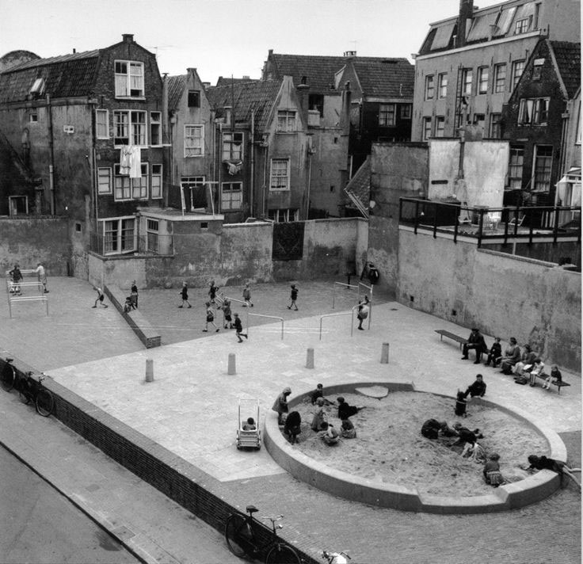
The Ringtales Playground: BoardGrove Architects
The Ringtales Playground was also inspired by the playgrounds designed by a Dutch architect called Aldo Van Eyck. He created over 700 playgrounds in Amsterdam the first was over 80 years ago! His designs included a sandpit and sometimes climbing bars and arches. Children from all the surrounding apartments would meet and play there for hours.
Why do you think it is/was important for children living in apartments to have a playground like this near their home?
You can see one of his playgrounds designed in 1947 in the image below.
Above: The Ringtales Playground at Incinerator Gallery Photo: Timothy Burgess.
Below: © Aldo van Eyck Archive / Amsterdam City Archive https://socks-studio.com/2018/02/11/human-structures-and- architectural-archetypes-aldo-van-eycks-playgrounds-1947- 1978/
The Ringtales Playground was designed by BoardGrove Architects who also created the exhibition design. They were inspired by the nearby Maribyrnong River and wanted to create a playground that reminded children of this precious water way. This playground has a water table that allows water to flow down to the sandpit, just like the river flowing from the mountains down into the bay.
Playing with sand and water is not only lots of fun but it allows you to be creative and invent your own play. The curvy monkey bars are fun too!
Why do you think monkey bars, sand and water are good to play on and with?

Slide 13
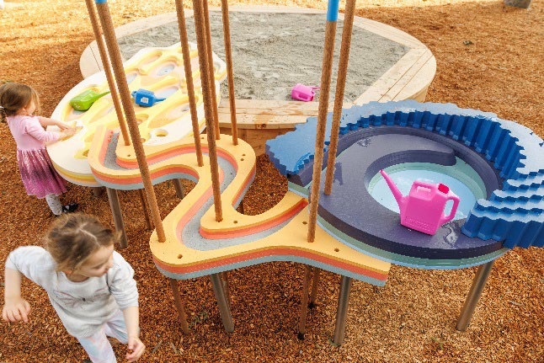
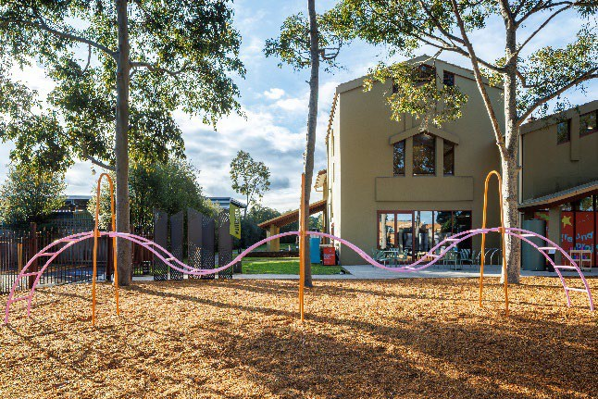
THE RINGTALES PLAYGROUND
SEE
Write a list of the shapes you can see on the water table?
Describe how the shapes are similar to the natural forms of the river and the mountains?
Why is the design of this playground fun to play on? OR What does the design teach us to do?
THINK
How has the water table been designed so the water flows down it easily?
What materials do you think this playground is made from?
Why do you think the designers called it The Ringtales Playground?
Take a guess and see the Fascinating Fact below with the answer!
WONDER
Why do you think the designers chose these colours for the water table? Can these colours be seen in the nature?
If you could make a playground that had water, sand and monkey bars what would it look like? Draw a blueprint of your design, label your diagram and explain what it would be made from and how it could be used.
Above: The water table and sand pit of The Ringtales Playground Photo: Timothy Burgess.
Fascinating Fact
The Maribyrnong River is also known as Mirring-gnay-nong in the Woi-wurrung language of the Wurundjeri people.
Can you fill in the letters to find out what it means?
‘I can hear a R _ _ _t _l _ Possum’
Above: The monkey bars part of The Ringtales Playground Melbourne Photo: Timothy Burgess.

Slide 14
THE RINGTALES PLAYGROUND ACTIVITY
CREATE
Work in pairs and design your own playground that has the elements of nature, sand and water and that also has some type of climbing frame to allow for risky play. You will make a small model/maquette of your playground.
Materials: Foundation - 4
Thick card square for the base, coloured paper, tissue paper, cellophane, sticky tape, a combination of icy pole sticks – coloured/plain, matchsticks- coloured/plain, construct-a- stick, pipe cleaners, corrugated card, thick white paper, paper straws.
Materials: Years 5 – 6 – Focus on a higher level of construction to be done over a few classes- look at architecture models for inspiration. Discuss possible materials if this design were to be realised.
Foamcore square base – (allows wire, small sticks to be secured in), armature wire, florist wire, paper form wire, matchsticks, toothpicks, construct-a-stick, icy pole sticks, balsa wood class pack or balsa sticks (if possible but not necessary) or small wooden cubes
THINK: How will you use sand and water in your playground? Will there be large sandpit or lots of smaller ones? Will you have flowing water or ponds or both? Where will your water come from? Will there be a tank to collect rainwater? What sort of climbing frame would you design? Could you climb up high and jump down? What colours will your playground be? Could you look at the colours and shapes in nature to give you some ideas? Will your playground be made from sustainable materials? Where will your playground be located?
DESIGN: Years 5 -6 Draw up a blueprint – this is what landscape architects, architects and designers do, basically it’s the plan for your playground design, use the prompting questions above to assist you with your design. Consider also where your playground will be, at a school, park, or urban setting. Will you incorporate landscaping with plants into your design?
CONSTRUCT: Use the materials to create your model. Paper and corrugated card can be cut folded, rolled curved into different shapes stuck together, cellophane and tissue can be used for landscaping elements like sand, water and plants. Sticks and wire can be used to create climbing frames and holding structures in place. experiment with materials as much as possible and find out all the different ways they can be used, experimentation will lead to an innovative design.

Slide 15
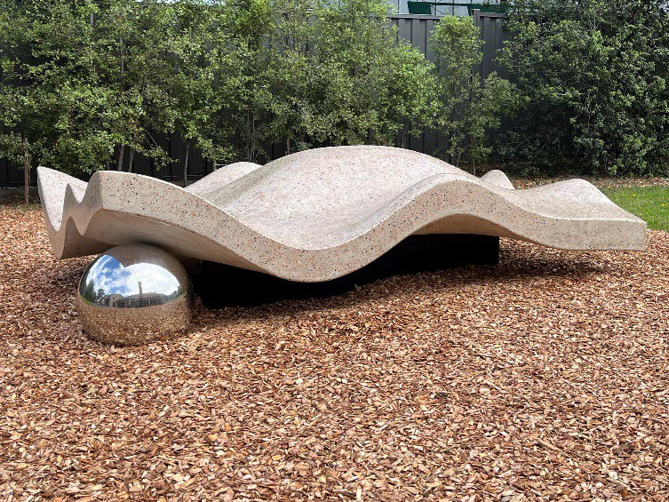
First Nations Playable Public Art Sculpture: Edwina Green
Can you see the sphere sitting underneath? The sphere represents a pearl found within an oyster. Oysters were a food source for the Wurundjeri people, who harvested them along the riverbanks of the Maribyrnong River. The texture of the sculpture represents the layered, ridged pattern of the oyster shells as Edwina explains,
‘Oysters, which feature strongly in coastal and saltwater mob, carry the history of Country in their shells: the tides, the seasons, and the gatherings that have taken place along the shoreline for generations’.
Above: Edwina Green artist illustration of First Nations Playable Public Art Sculpture.
The First Nations Playable Public Art Sculpture has been designed by Edwina Green, a Trawlwoolway, First Nations artist.
The Moonee Valley City Council commissioned Edwina Green to design the sculpture with a focus on the themes of childhood, play, togetherness and renewal. And for it to reflect how the Wurundjeri Woi- wurrung First Peoples have been connected to the Maribyrnong River for over 40,000 years.
Edwina was chosen from a number of First Nations Artists as the recipient (the receiver) of the commission. Edwina’s design provides creative and imaginative play opportunities for children and connects children to Country as she explains,
‘With its soft, undulating curves and organic shape, the form echoes the shifting contours of under water eco-systems found in the Maribyrnong River, it’s riverbeds, and the gentle rise and fall of the land’
SEE
Can you describe what you see – symbols, shapes, colour?
What more can you
see?
What material do you think this play sculpture is made from?
THINK
How does the design of Edwina’s play sculpture connect children to Country?
Edwina’s sculpture is connected to Wurundjeri Country but also to her ancestral Trawlwoolway Country. Can you find out where this is in Australia?
WONDER
Why is it important for First Nations artists like Edwina to tell stories about their Country and culture?
Why is it important for everyone to learn about First Nations culture and Country? How does it enrich our society?

Slide 16
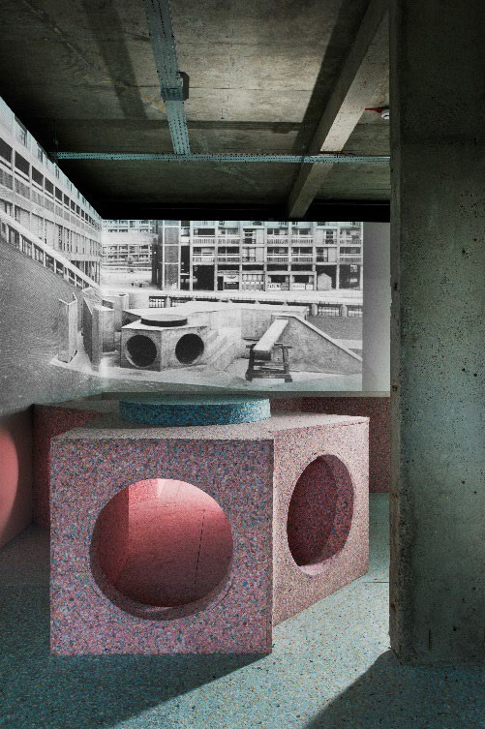
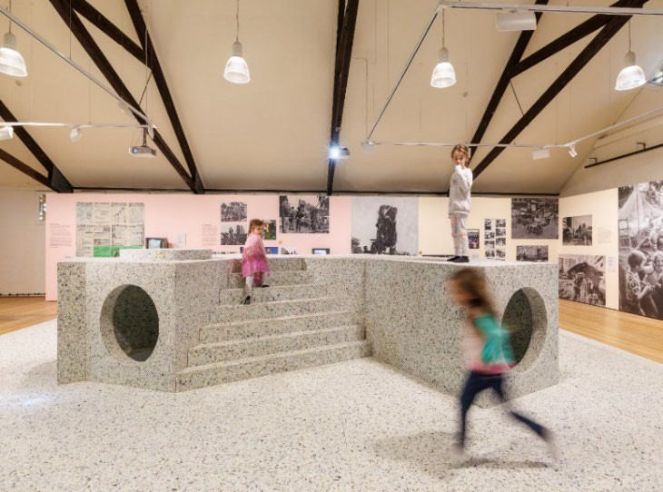
The Brutalist Playground Simon Terrill & Assemble
2.Left: ParkHill install view, S1 Artspace, UK, 2016.
Photo:Courtesy venue, artist and designers.
1.The Brutalist Playground, Incinerator Gallery, 2025 Photo: Timothy Burgess.
The Brutalist Playground was designed by Simon Terrill an Australian artist and a collective called Assemble who are a group of designers living in London.
SEE
Look at the above photo
(2). What are the similarities and differences between the old playground in the
photo on the wall and
the playground in the museum? When you look at The Brutalist Playground, what do you think it would feel like and how did it actually feel?
THINK
Can you think of some other materials that you would like this playground to be made from? How would it feel to play on?
How do you think this play sculpture was built? Do you think there is a structure underneath the soft foam?
Simon Terrill lives in London and when exploring the city, he discovered several playgrounds at the base of some large housing estates. These housing estates were built in the Brutalist style of architecture that was popular in the 1950’s, made up of concrete and geometric forms, they were big and harsh buildings. The playgrounds built at the same time as the brutalist buildings, also had large geometric forms that were made from concrete and steel just like the buildings.
Simon Terrill collaborated with the design collective Assemble, to recreate these brutalist concrete playground structures. They used foam to make them - a much softer material to play on than the concrete playgrounds.
The Brutalist Playground is an installation and play sculpture that allows people to experience the concrete brutalist playground in a whole new way and to discover and learn about a playground design from the past.
WONDER
Imagine yourself playing on the original concrete playground, what do you think it would be like and what games would you play? How would the play be different
from how you played on the one in the
gallery?
Page 16

Slide 17
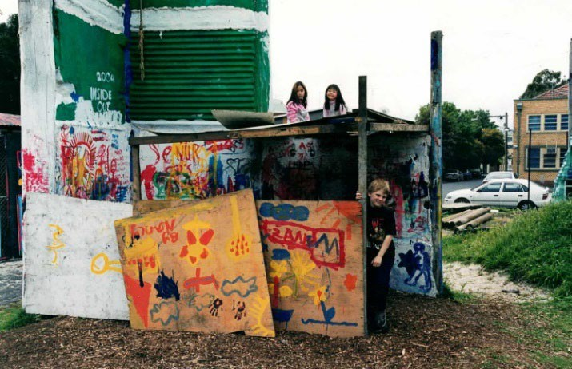
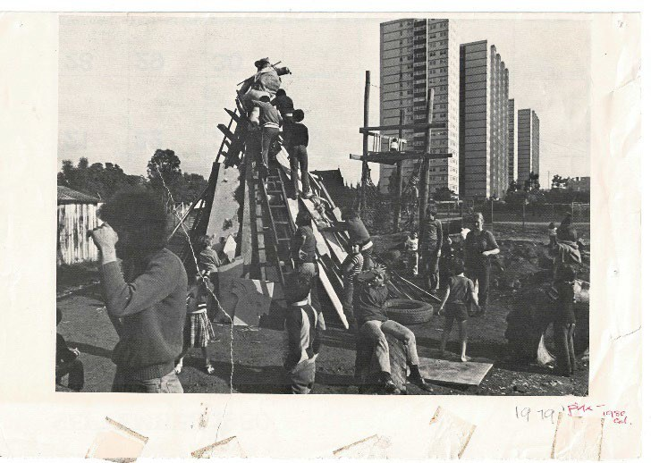
Adventure Playgrounds
After the Second World War, there was a change in childhood and education. Play began to be seen as important way for children to learn, problem solve together, be creative and was good for their wellbeing. In Europe parents, landscape architects and activists began creating Adventure Playgrounds that promoted creative play for children.
One of the first Adventure Playgrounds in Copenhagen, Denmark was inspired by a landscape architect called Carl Theodor Sørensen, he came up with the idea of Adventure Playgrounds as places that would have lots of old bits of found junk and natural materials for children to build, make and create a playground of their own.
The children enjoyed it so much and the benefits and success of this type of play for children soon spread around the world. Not long after Adventure Playgrounds were created around Europe, the United Kingdom and America.
Above: The Venny, Kensington. Photo: The Venny archive.
Did you know there are two Adventure Playgrounds in Melbourne?
They are called The Venny, in Kensington and The Cubbies in Fitzroy! They provide a space where children can create, build, invent, garden, play and much more!
CREATE
Materials: Loose parts – boxes of various sizes, cardboard tubes, wool, ribbon, and any other loose parts from Reverse Art Truck.
Collaborate: Work in groups to create a collaborative small scale playground with the loose parts that could be made into a permanent structure in your school yard. As you are making discuss what you would do on each part of the playgrounds, will it have tunnels, cubbies, areas to climb, rope swings etc
Discuss: As a group discuss how your collaborative design could be turned into a permanent playground, what would it be made from? Would it be sustainably made?
Above: The Cubbies, Fitzroy 1979. Photo: The Cubbies archive.

Slide 18
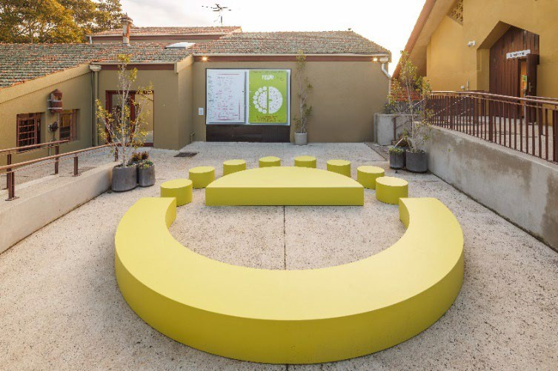
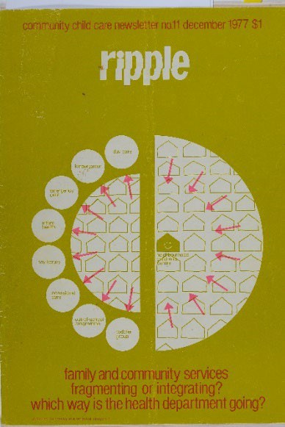
Round Table 2017 - 2025
Mary Featherston AM and Emily Floyd
SEE
How would the design of Round Table assist groups in sharing stories and ideas?
THINK
Why is it important for people in the community to gather and share ideas?
How would this type of seating be helpful in a community
setting?
Above: The Round Table at Incinerator Gallery for The Playground Project Melbourne 2025
WONDER
What are some things that are
important to you and your classmates, that you could discuss at the Round Table?
If you were to create some seating for outdoors at school what would it look like and what would you make it from? Draw a picture of your design, label it
and describe why it would be good for you and school friends to use.
As part of The Playground Project Melbourne, Incinerator Gallery invited Australian artist Emily Floyd and English/Australian interior designer Mary Featherston AM to exhibit their well-known collaborative sculpture ‘Round Table’ 2017.
Both Emily and Mary are interested in alternative education that focuses on creativity, play and social connection. The Round Table has been made as a place for people to gather and share ideas, stories and experiences. They are interested in people and communities connecting to bring about change that will improve people’s lives.
Round Table re-creates a cover design by Mary Featherston for a 1970’s community childcare magazine called Ripple, (image on the right) Emily’s mother, Frances Floyd worked on this magazine as well, which is why Emily decided to create Round Table with Mary Featherston.
Above: Mary Featherston, Ripple cover design.

Slide 19
Curriculum Links
Visual Arts Level F – 2
Content Descriptions VC2AVAFE01 VC2AVAFE02 VC2AVA2E01
Design and Technologies
Level F – 2
Technologies and Societies VC2TDE2S01
Technologies Contexts VC2TDE2C04
Creating Designed Solutions VC2TDE2D02
VC2TDE2D04 VC2TDE2D05
Level 3 – 4
Technologies and Societies VC2TDE4S01
Technologies Context VC2TDE4C04
Creating Designed Solutions VC2TDE4D04
VC2TDE4D02 VC2TDE4D05
Developing Practices VC2AVAFD01 VC2AVA2D01
Creating VC2AVAFC01 VC2AVA2C01
Level 3 - 4
Content Descriptions VC2AVA4E01 VC2AVA4E02
Developing Practices VC2AVA4D01
Creating VC2AVA4C01
Level 5 – 6
Technologies and Societies VC2TDE6S01
Technologies Context VC2TDE6C04
Creating Designed Solutions VC2TDE6D01
VC2TDE6D05 VC2TDE6D02
Level 5-6
Content Descriptions VC2AVA6E01 VC2AVA6E02
Developing Practices VC2AVA6D01
Creating VC2AVA6C01

Slide 20
Curriculum Links cont…
Humanities – History Level F – 2
Historical Concepts and Skills VC2HH2S01
VC2HH2S02 VC2HH2S03 VC2HH2S04
VC2HH6S04 VC2HH6S05 VC2HH6S09
Communicating VC2HH6S10
Aboriginal and Torres Strait History and Cultures
Country and Place VC2CCPACP1
Culture VC2CCPAC2 VC2CCPAC3
Continuity and Change VC2HH2S05 VC2HH2S07
Communicating VC2HH2S08
Level 3 – 4
Historical Concepts and Skills VC2HH4S01
VC2HH4S02 VC2HH4S03 VC2HH4S04
Continuity and Change VC2HH4S06
People VC2CCPAP2 VC2CCPAP3
Personal and Social Capability Level F – 6
Social Awareness and Management VC2CPFO03
VC2CP2O04 VC2CP4O04 VC2CP6O04
Communicating VC2HH4S09
Level 5 – 6
Historical Concepts and Skills VC2HH6S01
Continuity and Change VC2HH6S02

Slide 21
Glossary
Architect
Plans, designs and oversees the construction of buildings, homes and other structures.
Art Collective
A group of artists working together to create and exhibit a collaborative work of art.
Commission
A commission is when an organisation or an individual pays an artist to create a work of art, they may ask the artist to focus on a certain theme or concept for the artwork.
Exhibition Design
Is the layout of the exhibition which includes where the artwork is placed within the gallery either on walls, floor, plinths or in cabinets, the placement of information texts called didactics, installation of internal walls if needed, colours of the walls etc
Installation Art
A large scale constructed artwork, often made for a specific place amount of time.
Kinetic Sculpture
and only up for a set
Is a sculpture that depends on motion for its effects – motion from wind or motor.
Sculptor
An artist who makes three dimensional artworks, called sculptures. They can use a variety of materials, some of which could be metal, clay, wood, existing objects, wire, bronze etc
Sculpture
Three-dimensional art that you can walk around. It can be made by four basic processes: carving, constructing, modelling and casting.
Landscape Playground
A playground that is designed to integrate play into the surrounding landscape. It aims to encourage play that is creative, physically engaging and imaginative by providing a varied play experience where children can interact with the surrounding environment.
Adventure Playground Is a playground that offers endless possibilities of free play, where there are lots of loose parts and natural materials where children can build cubbies, and other structures to play on and in. It is constantly changing and re-inventing itself as children are the creators of these playgrounds, often overseen by parents.

Slide 22
Landscape architect
A person who designs public outdoor spaces that combines parks and gardens with buildings, playgrounds, walking/bike paths and roads.
Play Sculpture
A large-scale sculpture that can be played on and interacted with. It provides a different experience from a traditional playground.
Urban Design
Planning of cities, towns and public spaces. It involves the integration of buildings, roads, landscapes, playgrounds and other public facilities to create functional, sustainable and enjoyable environments for people to live in.
Visual Artist
Creates visual works of art. Mediums can include – paper, paint, paper, wood, clay, video, metal etc to name a few.

Slide 23
Website links to key designers, artists and playgrounds:
Curator: The Playground Project Melbourne- Gabriela Burkhalter, Switzerland https://incineratorgallery.com.au/exhibition/the-playground-project-melbourne/ https://www.broadsheet.com.au/melbourne/event/playground-project-melbourne https://www.e-flux.com/announcements/661355/the-playground-project- melbourne
https://www.transfer-arch.com/playground-project/
Egon Moller-Nielson – lekskulptur Tuffsen 1949 https://kulturportallund.se/en/tufsen-the-timeless-play-sculpture/ https://barnboken.net/index.php/clr/article/view/433/1487 https://www.artsy.net/article/artsy-editorial-picasso-noguchi-11-artists-designed- spectacular-playgrounds
Aldo van Eyck – Bertelmanplein playground
https://socks-studio.com/2018/02/11/human-structures-and-architectural-archetypes- aldo-van-eycks-playgrounds-1947-1978/
Isamu Noguchi, Japan/ America – Models of Ala Moana Park, Playscapes in Piedmont Park, 1975-76, Play sculpture, Octetra, 1968 https://www.noguchi.org/museum/exhibitions/view/in-search-of-contoured-playground/ https://champ-magazine.com/art/isamu-noguchi-play-equipment/ https://www.noguchi.org/museum/exhibitions/view/isamu-noguchi-a-new-nature/ https://www.artsy.net/article/artsy-editorial-picasso-noguchi-11-artists-designed- spectacular-playgrounds
Anita Aarons, Australia – Earth Mother 1952
https://www.cityofsydney.nsw.gov.au/sculptures/earth-mother-play- sculpture#:~:text=The%20play%20sculpture%2C%20known%20as,surfaces%20have%2 0a%20smooth%20finish
https://www.daao.org.au/bio/anita-aarons/biography/
M. Paul Friedberg, America – Riis Plaza, Jacob Riis Houses https://www.mpfp.com/projects/riis-park-plaza https://www.landscapearchitecture.nz/landscape-architecture-aotearoa/friedberg-life
Mitsura Senda, Japan – Giant Path Play Structure, 1969 and Cosmos,1975 https://crosspollenblog.wordpress.com/2019/12/16/playing-for-history-notes-on-the- playground- project/#:~:text=He%20notes%20too%20a%20direct,they%20will%20inherit%20as%20 adults.

Slide 24
Niki de Saint Phalle, France – Golem, 1972 https://nikidesaintphalle.org/the-story-of-a-monster/
Joseph Brown, America – Whale, 1955 https://francisquirk.blogspot.com/2020/02/francis-quirk-and- boxersculptorplaygrou.html
https://berliner-seilfabrik.com/en/productgroup/univers/joe-brown-collection/ https://www.tate.org.uk/tate-etc/issue-31-summer-2014/when-play-got-serious
Paul E. Selinger, America – Shek Lei Playground, Hong Kong, 1970 https://www.mplus.org.hk/en/magazine/a-brief-history-of-playgrounds-in-hong-kong/ https://www.archdaily.com/1032761/playscapes-and-public-imagination-the- ambiguous-play-in-urban-life-of-hong-kong
Adventure Playgrounds
The Venny: https://thevenny.org.au/
Joan Healey: https://publishing.monash.edu/product/the-cubbies/
Adventure Playgrounds Sweden: https://formdesigncenter.com/en/city-play-past-and- present
Lady Marjorie Allen: https://wearecapco.com/news/why-kids-need-risk-celebrating-the- life-of-marjory-allen/
https://rethinkingchildhood.com/2013/06/24/lady-allen-godmother-play/
BoardGrove Architects
https://incineratorgallery.com.au/exhibition/the-playground-project-melbourne/
Simon Terrill & Assemble
https://assemblestudio.co.uk/projects/the-brutalist-playground https://www.archdaily.com/633677/assemble-to-construct-a-brutalist-playground-at- riba

Slide 25
For more information
Visit https://incineratorgallery.com.au/exhibition/the-playground-project-melbourne/ and to learn more about the exhibition and other exhibitions at Incinerator Gallery.
Contact us Incinerator Gallery
180 Holmes Rd Aberfeldie 3040 Wurundjeri Woi-wurrung Country 03 9243 1750
incinerator@mvcc.vic.gov.au

Slide 26
